Slide 1
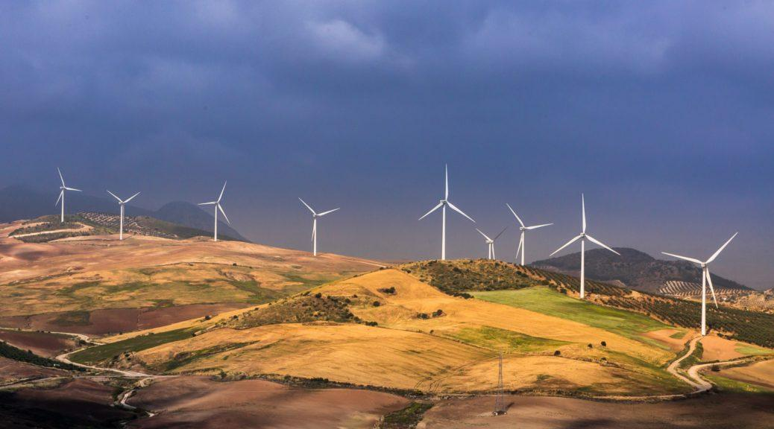
Predicting Energy Prices
based on energy and weather data in Spain from 2015-2018
Kera Lagios
Springboard Capstone 02
October 20, 2024
https://www.evwind.es/2019/06/17/the-extension-of-life-of-wind-farms-a-new-challenge-for-wind-energy-in-spain/67616

Slide 2
Problem Statement
How does weather and energy generation/load information affect price of energy in Spain?
Objective
Develop a model that can predict price (Euros)/megawatt (MW) based on energy and weather data.
Scope
Weather information is included for five cities in Spain, however, these cities are not necessarily, or even likely, located where the solar, wind and hydro generation takes place.
Other economic data that could affect price, including information how much is sold or bought from neighboring countries is not included.
Data sources & other important information
Kolasniwash, 2019: “Hourly energy demand generation and weather”. Kaggle, accessed August 17, 2024, https://www.kaggle.com/datasets/nicholasjhana/energy-consumption-generation-prices-and-weather https://transparency.entsoe.eu/
https://www.esios.ree.es/en/market-and-prices https://openweathermap.org/api

Slide 3
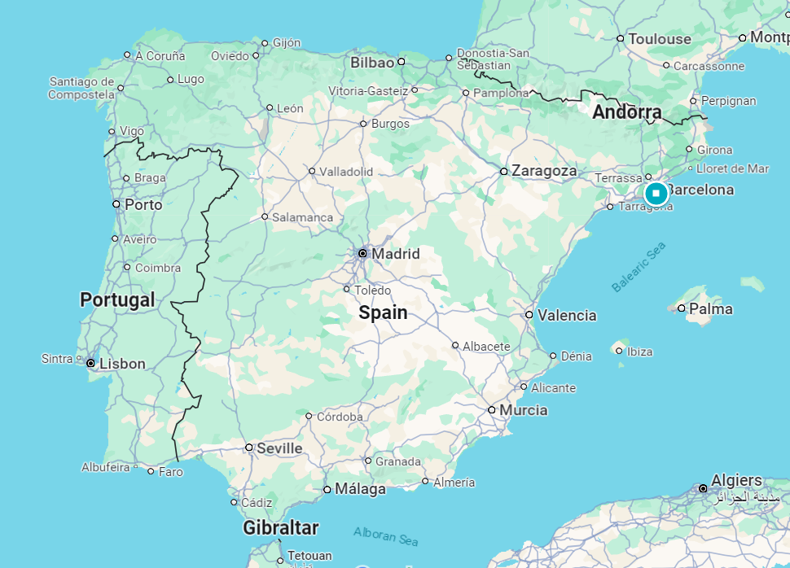
The cities included in the weather data for this study include: Barcelona, Bilbao, Madrid, Seville and Valencia.

Slide 4
Data Description
Two data sets: energy and weather
Data is hourly
Each dataset is four years from January 1, 2015 to December 31, 2018.
Weather data set: numerical and categorical features
Example numeric features: temperature, humidity, pressure, wind speed, wind direction
Energy dataset included numerical features
Example features: fossil hard coal, fossil gas, wind onshore, and nuclear
Additionally the following features were included: price actual, price day ahead, forecast wind onshore day ahead, forecast wind offshore day ahead, total load forecast, total load actual
Data was aggregated by day, and the maximum value was taken.

Slide 5
Missing Data & Additional Features
Added features: month
day of week
total generation
difference between load and generation
No missing weather data
Energy generation features
without data:
Fossil coal-derived gas
Fossil oil shale
Fossil peat
Geothermal
Marine
Wind offshore
Hydro pumped storage agg
Forecast wind offshore day ahead
Features dropped from weather data:
Categorical features
Wind direction

Slide 6
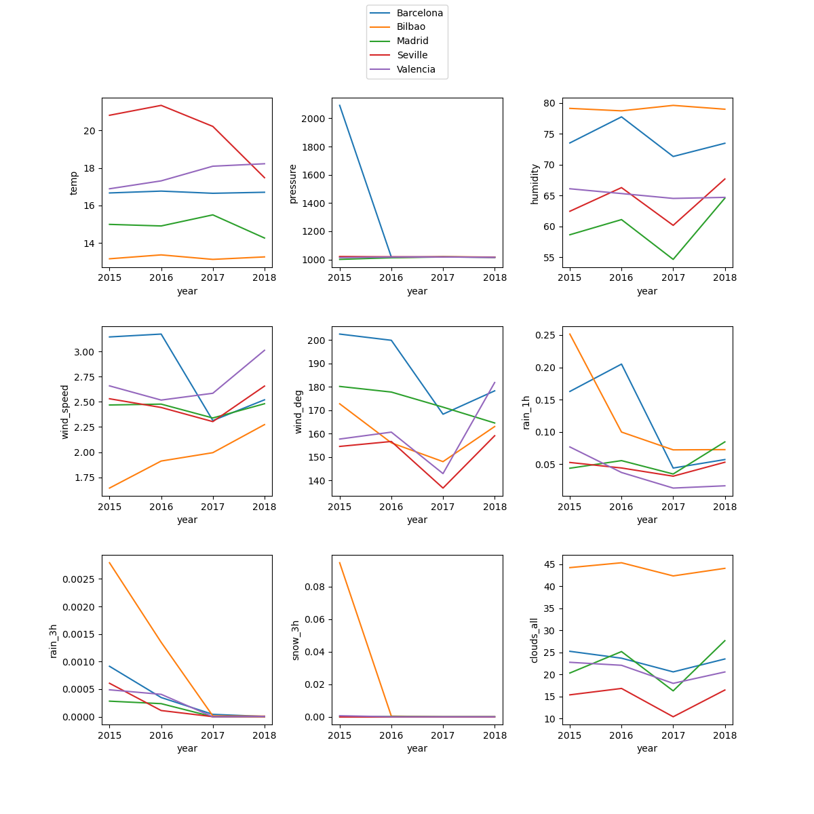
Bilbao and Barcelona are the most humid
Seville is the warmest, Bilbao the coolest
Bilbao is cloudiest
Dry 2017-2018

Slide 7
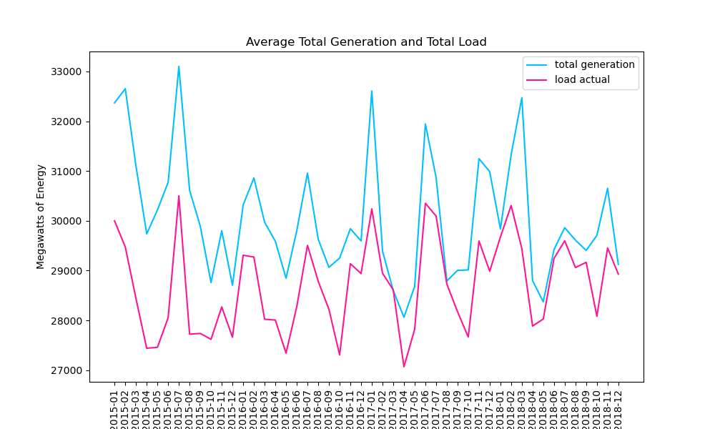
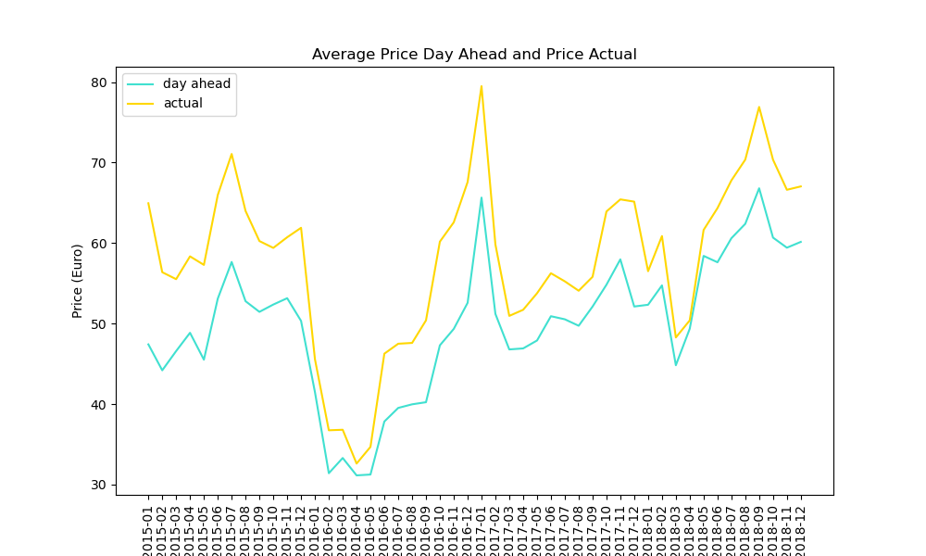
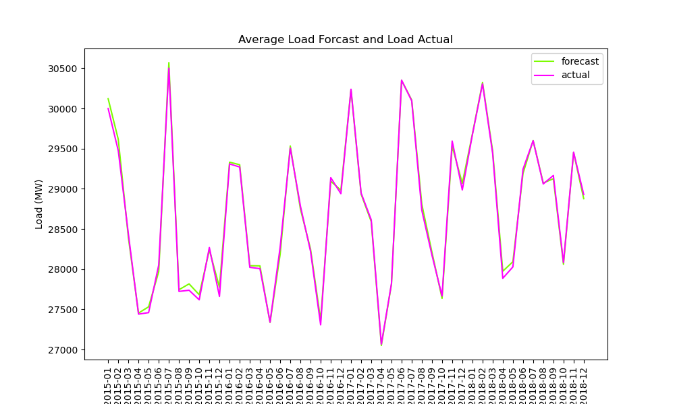
Generation is higher than load, meaning there is generally enough energy and no power outages or blackouts.
Price actual is higher than price day ahead.
In general, Spain is very good at predicting load, as the two curves are almost identical.

Slide 8
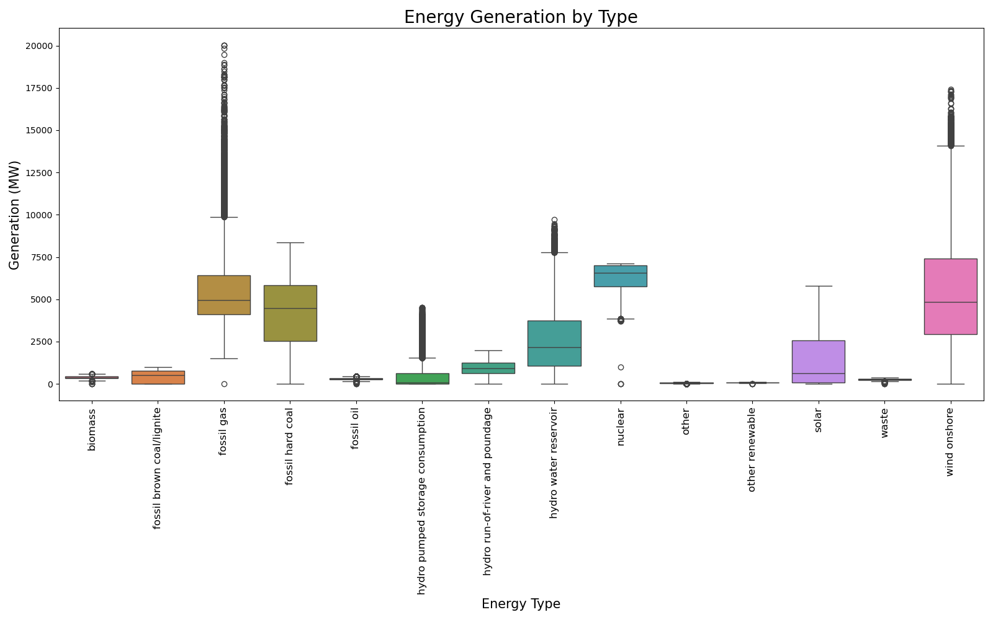
Highest median hourly generation:
Nuclear
Fossil gas
Fossil hard coal
Wind onshore
Hydro water reservoir

Slide 9
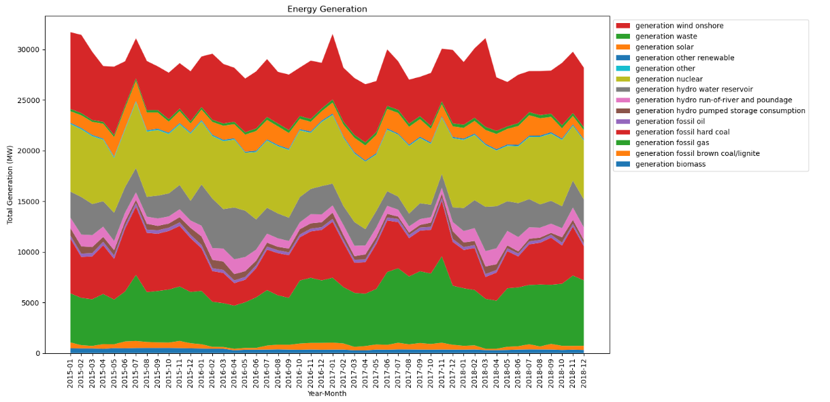

Slide 10
generation wind onshore
generation nuclear
generation hydro water reservoir
generation fossil hard coal
generation fossil gas

Slide 11
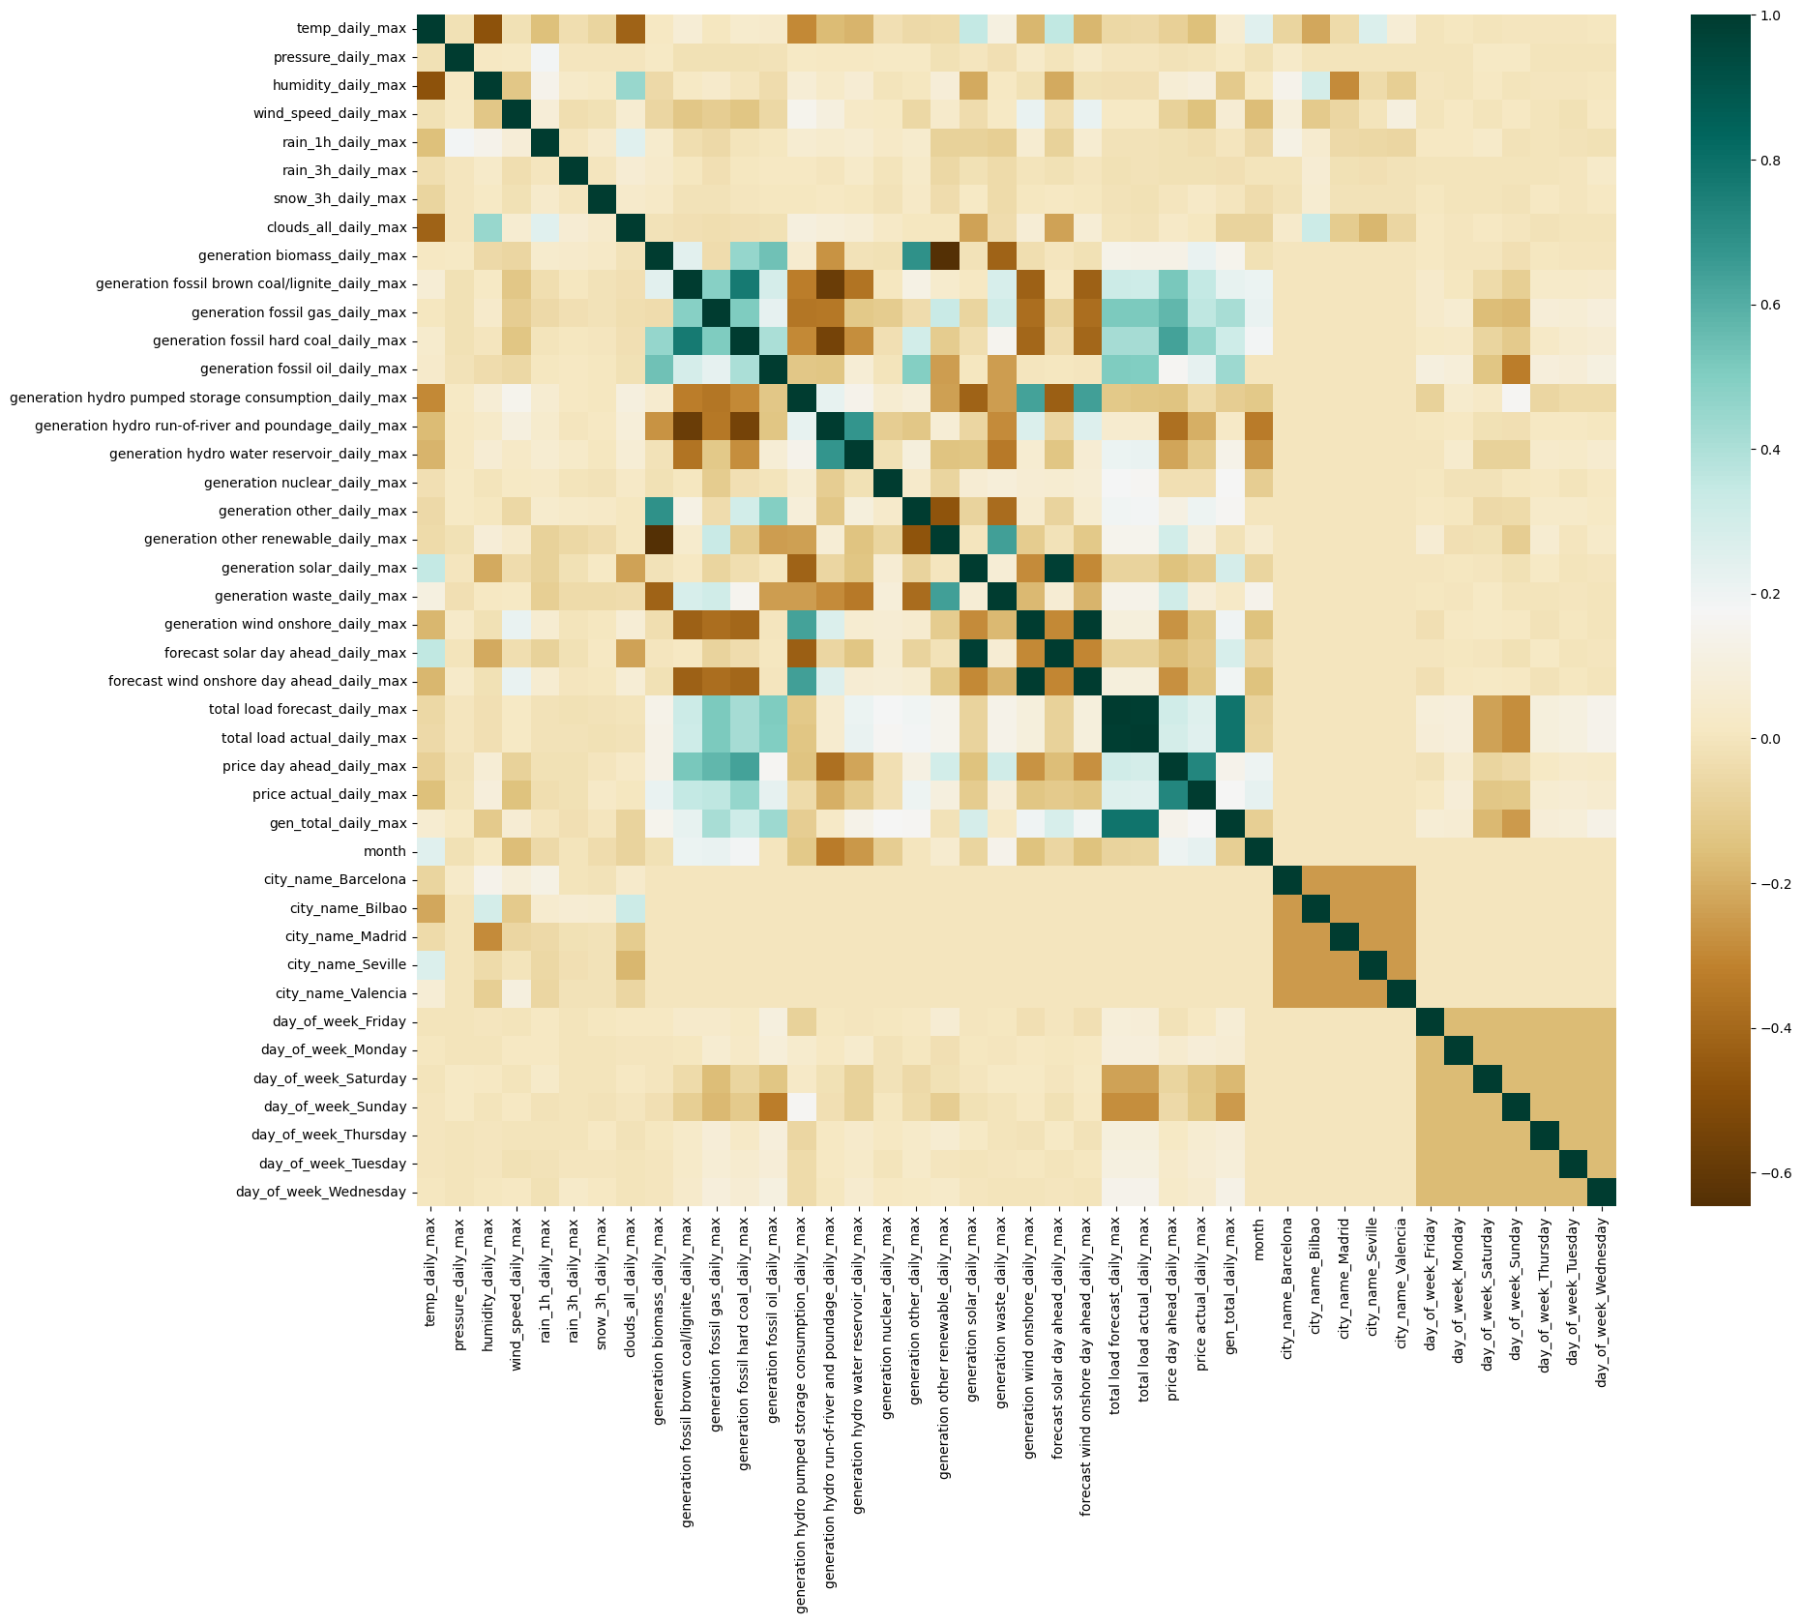
Correlation heatmap
Dark green: positive correlation (as one feature increases the other increases)
Dark brown: negative correlation (as one feature increases the other decreases)
Map is “mirrored” along the diagonal
The large amounts of beige reflects a zero correlation for many of the features.
The few dark areas mean there are not a lot of strong correlations

Slide 12
Correlation heatmap
weather
energy
month
city
day of week

Slide 13
Correlation heatmap
month
weather
energy
city
day of week

Slide 14
Correlation heatmap
generation fossil hard coal daily max
generation wind onshore daily max
price actual daily max

Slide 15
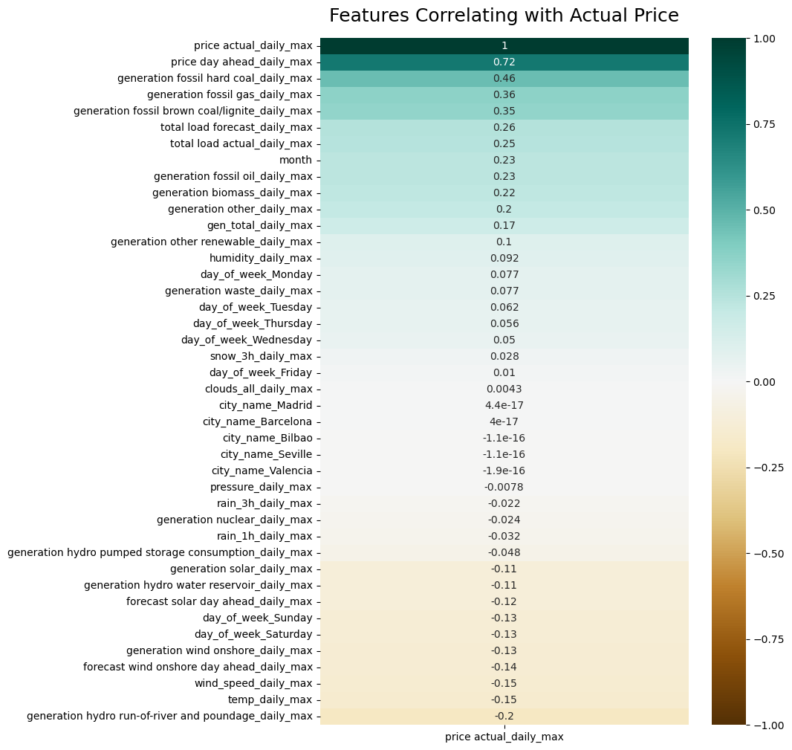
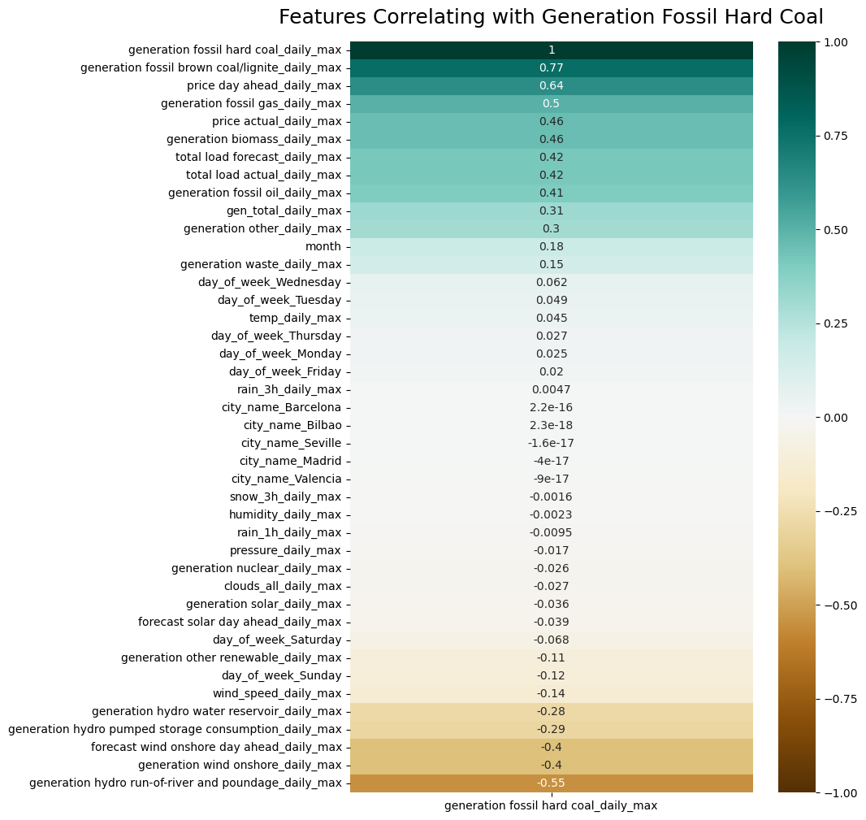
Ranked correlations by feature
Only one feature with a correlation >0.40 or <-0.40
Several features with correlations >0.40 or <-0.40

Slide 16
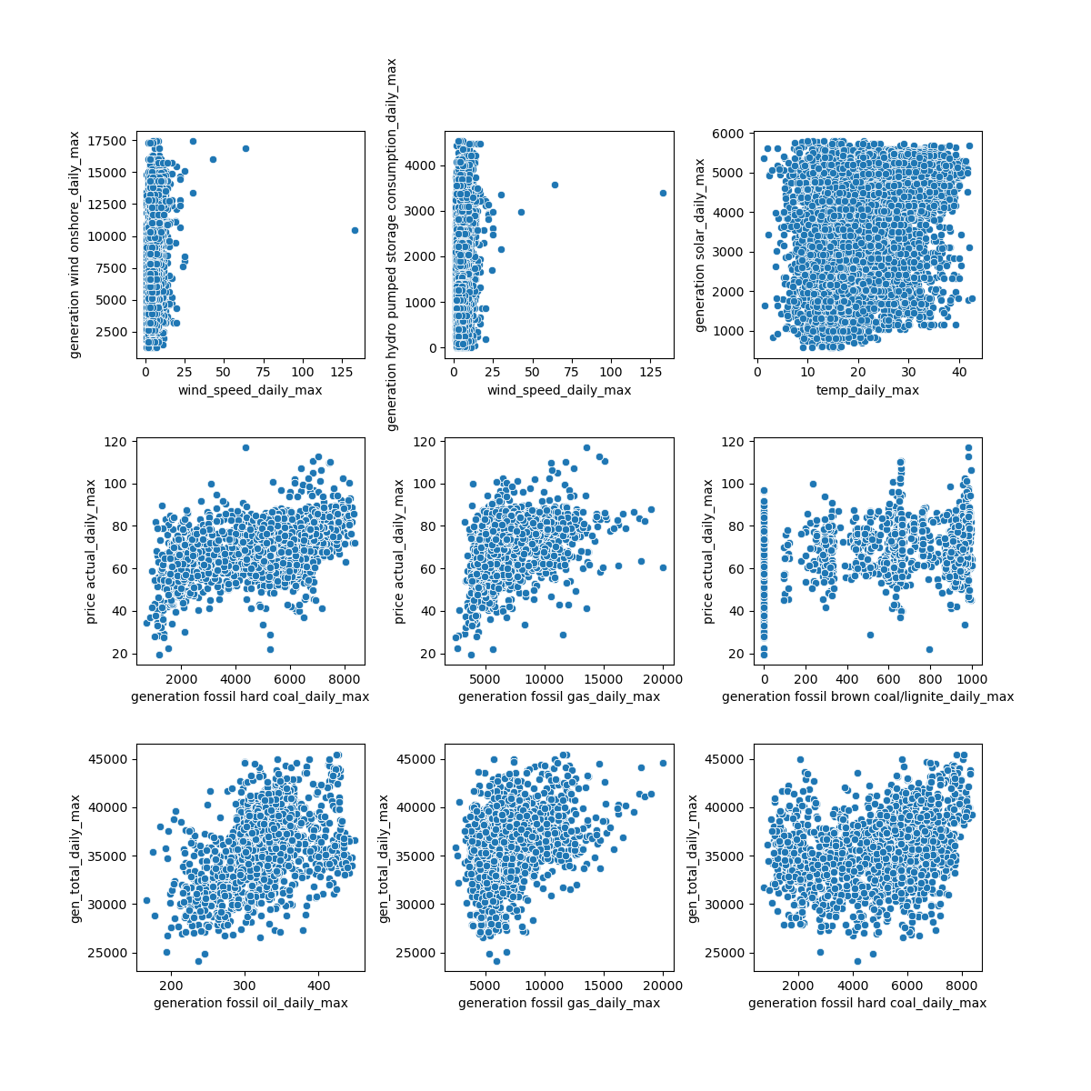
Scatter plots of selected features
Strong linear relationships in scatter plots would appear as the dots clustered along a diagonal line
Only weak linear relationships are visible in some of these plots

Slide 17
Key Modeling Steps
Joining the energy and weather data sets.
Shifting features one day ahead to prevent the model from “knowing” information that would not be available until the next day.
Linear regression modeling including cross-validation and hyperparameter tuning.
Random forest regression modeling including cross-validation and hyperparameter tuning.

Slide 18
Linear Regression
Random Forest Regression
7.17€
Mean absolute error
0.76€
Mean absolute error
1000
Best n_estimators (number of trees)
31
Best value of k
0.9624
Mean cross-validation score
0.4739
r-squared

Slide 19
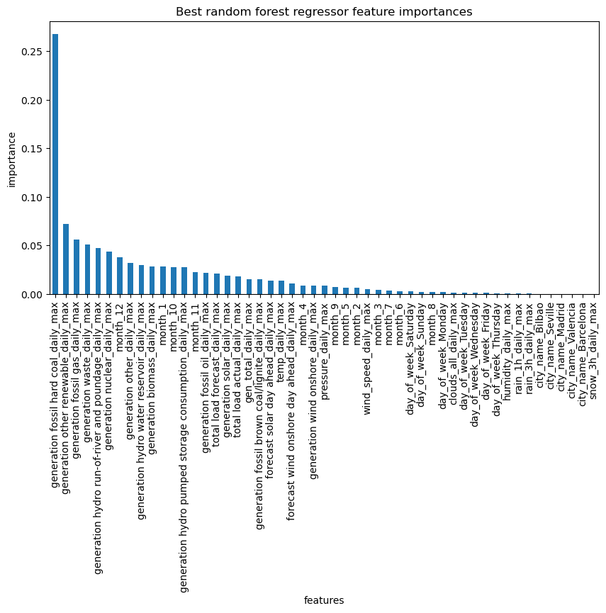
Random Forest Regression Modeling
Most important features

Slide 20
Random Forest Regression Modeling
Least important features

Slide 21
Recommendations and Key Findings
In general this model and results provide several uses and insights:
First the model can be used to predict future prices of energy in Euros/MW given weather and energy data in Spain, although predicting beyond 2018 would ideally include more up-to-date data..
The most important features include:
Hard coal
Other renewables
Gas
Waste
Hydro run-of-river and poundage
Nuclear
Fall and winter months (October through January)
Ideally better understanding the generation of these sources and the influence of fall-winter months, would help understand price fluctuations.
Hard coal:
Significant factor in price and in its correlation map
The feature with the highest correlations with other features in the dataset
The most important factor in the best performing model.
It is worthwhile to understand hard coal generation in order to better understand both price and other movements in energy generation.

Slide 22
Future Work
Future work could include using other algorithms and potentially non-linear options to see if they improve performance by reducing the complexity of the models. Additionally, examining the data without summarizing by the maximum value per day would be useful to gauge if it has any impact on the results. Lastly, it would be interesting to do more research into the general lack of correlation between weather and price or generation, potentially looking more closely at the wind and solar weather data, and price and wind and solar generation to better understand that relationship.

